Slide 1
Front End Development
By Stephen Sladek

Slide 2
Why Learn Front End Development?
Many employers expect somebody with computer in their degree name to be able to make a webpage
More opportunities for contract work
Median salary of $51,000 – 76,000 a year for freelance web developers
Understand your future coworkers’ role
College isn’t going to teach it to you
(Unless you’re a graphic design student)

Slide 3
What is Front End Development?

Slide 4
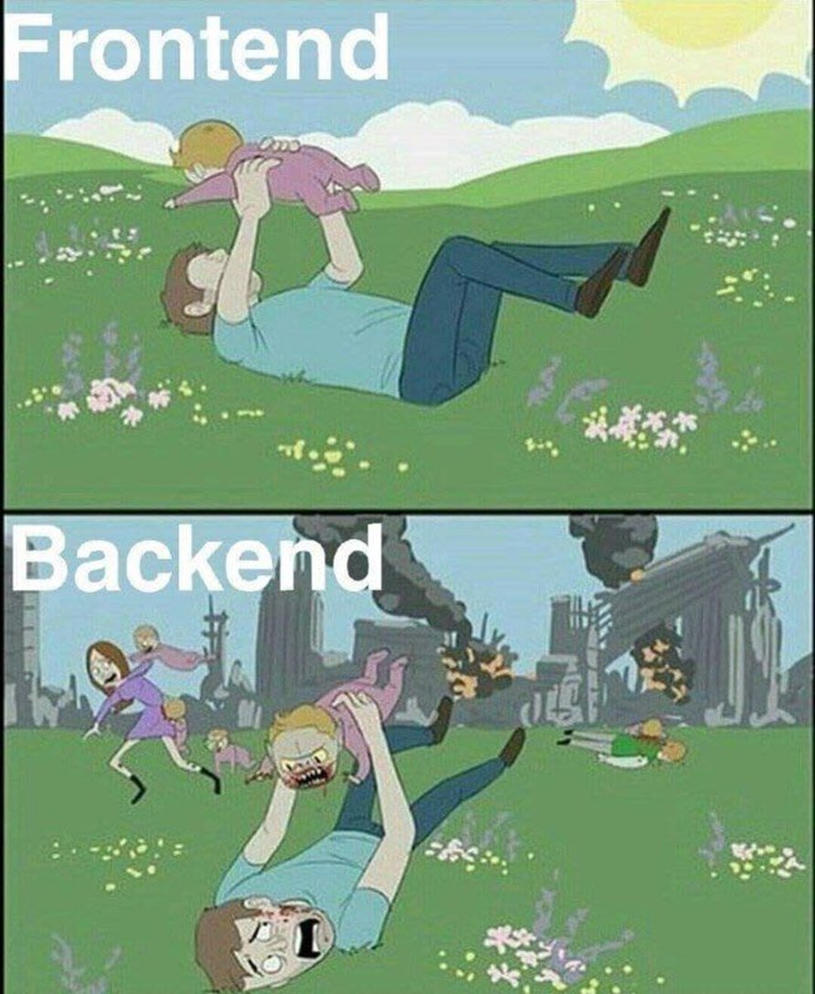

Slide 5
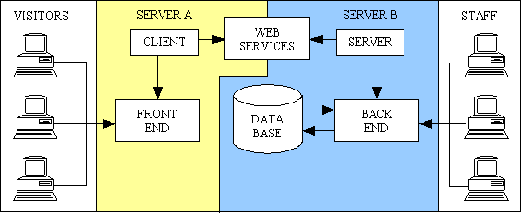

Slide 6
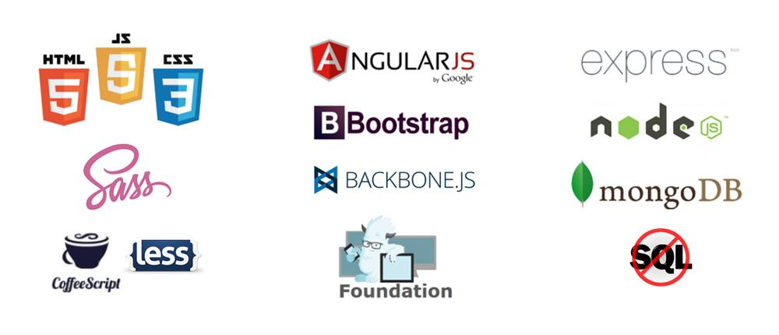
Front End Languages

Slide 7
The Trifecta

Slide 8
Languages built off of JavaScript
jQuery – Lightweight scripting language for DOM
React – Quick user interface development. By Facebook
TypeScript – Now has types! By Microsoft
MongoDB – A NoSQL database
ExpressJS – Server framework for Node, used for web apps and APIs
AngularJS – Uses Model View Controller to build web apps. By Google
NodeJS – Runs JS without a browser. Can access server side
JSON – Used by many APIs to send data in key/value pairs

Slide 9
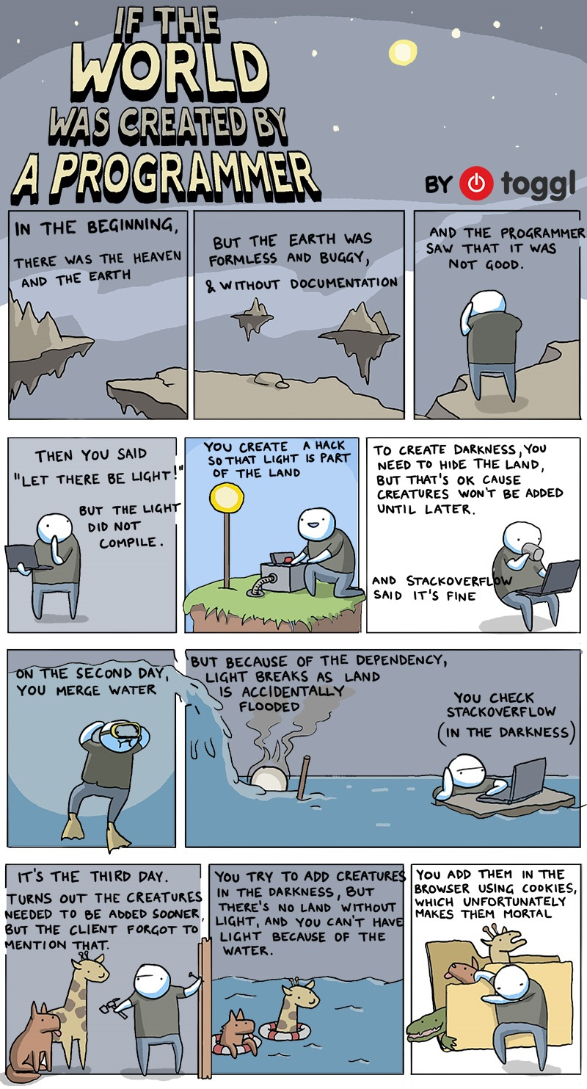

Slide 10
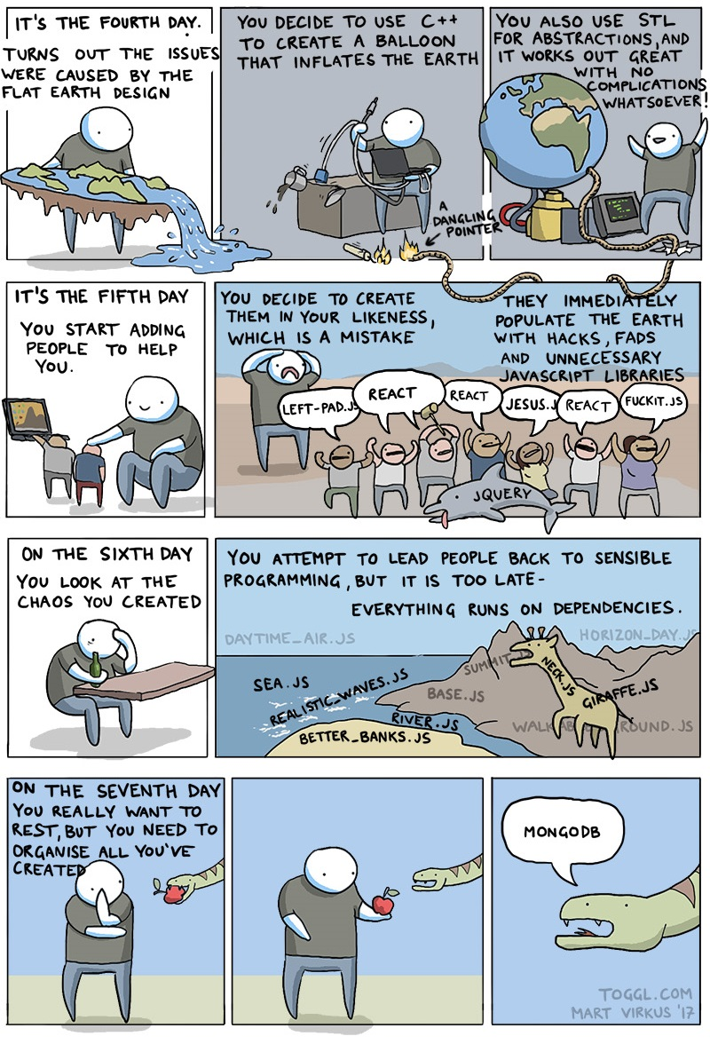

Slide 11
History of JavaScript
Made in 1995 based off of Netscape’s ECMAScript in a joint collaboration between Sun Microsystems and Netscape.
As of 2016 Google Chrome conforms to 93% of EcmaScript’s features while Mozilla Firefox supports 77%.
JavaScript is a trademark owned by Oracle. EcmaScript is a standard that general purpose scripting languages conform to.

Slide 12
Features of JavaScript

Slide 13
Interpreted

Slide 14
Typing
Weakly typed
Kind of like using auto for everything in C++
Has no classes
Prototypes = extremely object oriented
Anything can go into an array
6 Primitives
String
Number
Boolean
Undefined – has no value assigned
Null – has a value of no value assigned
Symbol – used for unique identifiers

Slide 15
Equals vs Equals
==
===
Used for loose comparisons
1 == “1” returns true
1 == 1 returns true
Used for strict comparisons
1 === “1” returns false
1 === 1 returns true

Slide 16
Let’s give it a try

