Slide 1
Association for Computing Machinery at Southeast Missouri State University
VIRTUAL REALITY
By Stephen Sladek

Slide 2
Virtual Reality
History
How it Works
Tools of VR
How it’s Used

Slide 3
History - 1838
The stereoscope was invented by Sir Charles Wheatstone. This was the first invention of a 3D display.

Slide 4
History - 1968
The Sword of Damocles was the first VR device ever created. Made by Ivan Sutherland of MIT.

Slide 5
History - 1995
Nintendo launches the Virtual Boy, the first consumer VR device to hit the shelves.
It is a commercial failure due to the uncomfortable stationary design, monochromatic red, and high price tag.

Slide 6
History – Honorable Mentions
View-Master 1939
Consumer device for stereoscopic reels
Project Headsight 1961
Stereoscopic HMD for the military
Sensorama 1962
3D multisensory theater
Virtuality Arcade 1991
Arcade with built-in VR headset
Sega VR Glasses 1993

Slide 7
History - 2012
Oculus hits Kickstarter and raises $2.4 million. Nearly %1000 of the original target.
The low cost solution of utilizing smart phone components along with exposure to several gaming conventions helped launch its popularity.

Slide 8
Palmer Luckey

Slide 9
1990s VR vs. Present VR

Slide 10
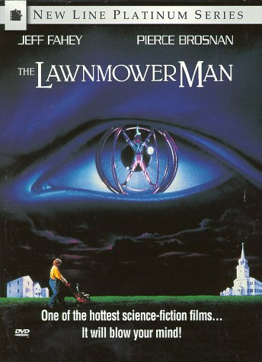
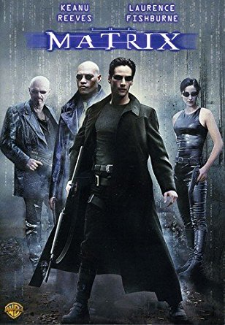
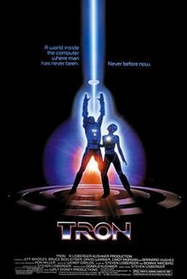
Popular Virtual Reality Movies / Series
Tron 1982
Lawnmower Man 1992
The Matrix 1999
Sword Art Online 2012
Log Horizon 2013
Ready Player One 2018

Slide 11
How it Works

Slide 12
How it Works
Required
Not Required
Optics
Focal Length
Field of View
Stereoscopy
Rotational Tracking
Low Persistence*
Spatial Audio
Positional Tracking
Haptic Feedback
Eye Tracking

Slide 13
How it Works
Low Persistence
Displays a moving slice at high fps
Reduces motion blur which, in turn reduces motion sickness
Example

Slide 14
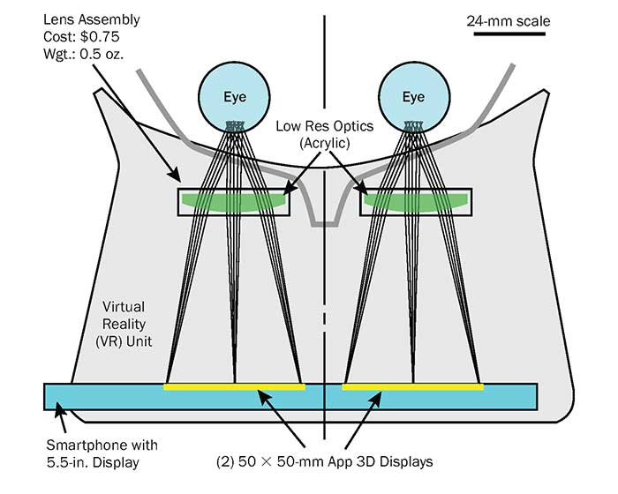
How it Works
Optics
Thin acrylic lenses for small HMD
Thick plastic lenses for large HMD
Focal Length
Distance between human eye, optics, and the screen

Slide 15
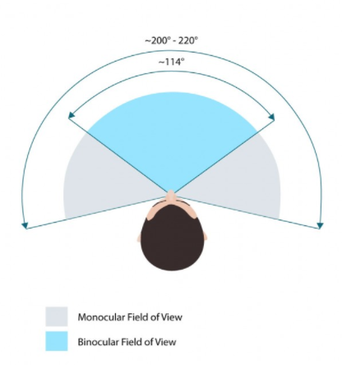
How it Works
Field of View (FOV)
Average human has ~200 degree FOV
Perceive symbols at 60 degree and read text at 10 degrees
We only care about the binocular FOV
VR Headsets typically range from 90 – 110 degree FOV

Slide 16
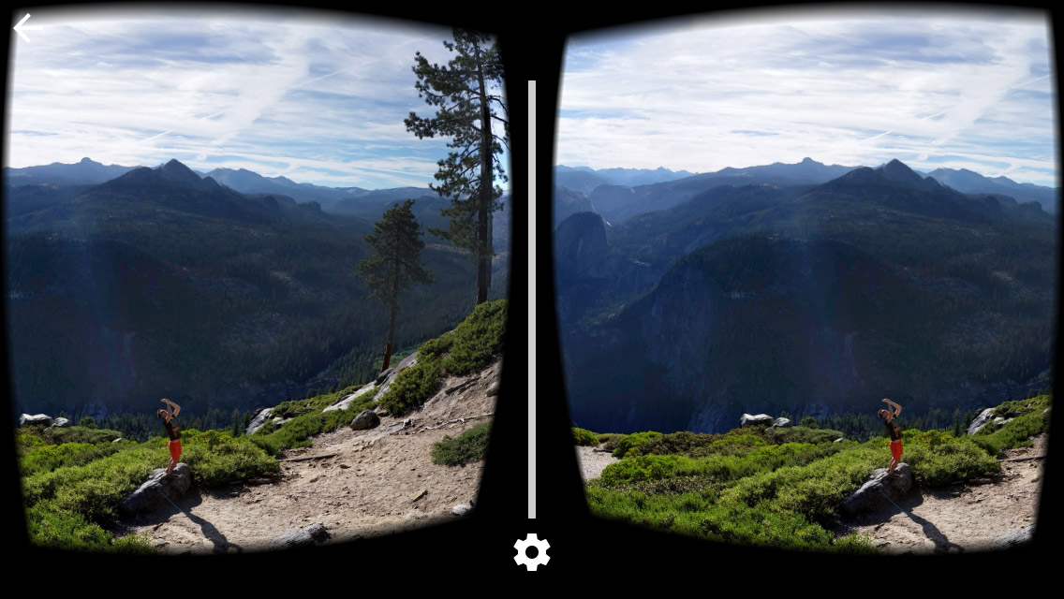
How it Works
Stereoscopy – the seeing of objects in three dimensions
Creates two offset images to imitate what our eyes do
If lined up correctly, our brain will handle the rest of the processing

Slide 17
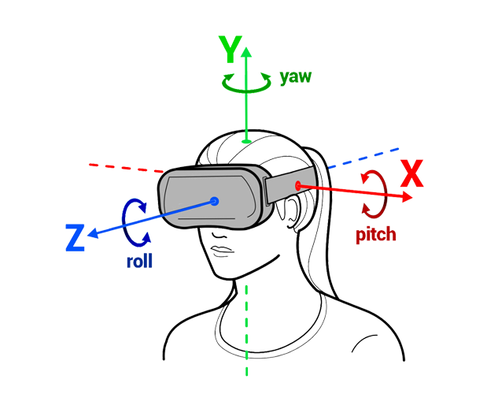
How it Works
Rotational Tracking
Inertial Measurement Units (IMU)
Accelerometer
Magnetometer
Gyroscope

Slide 18
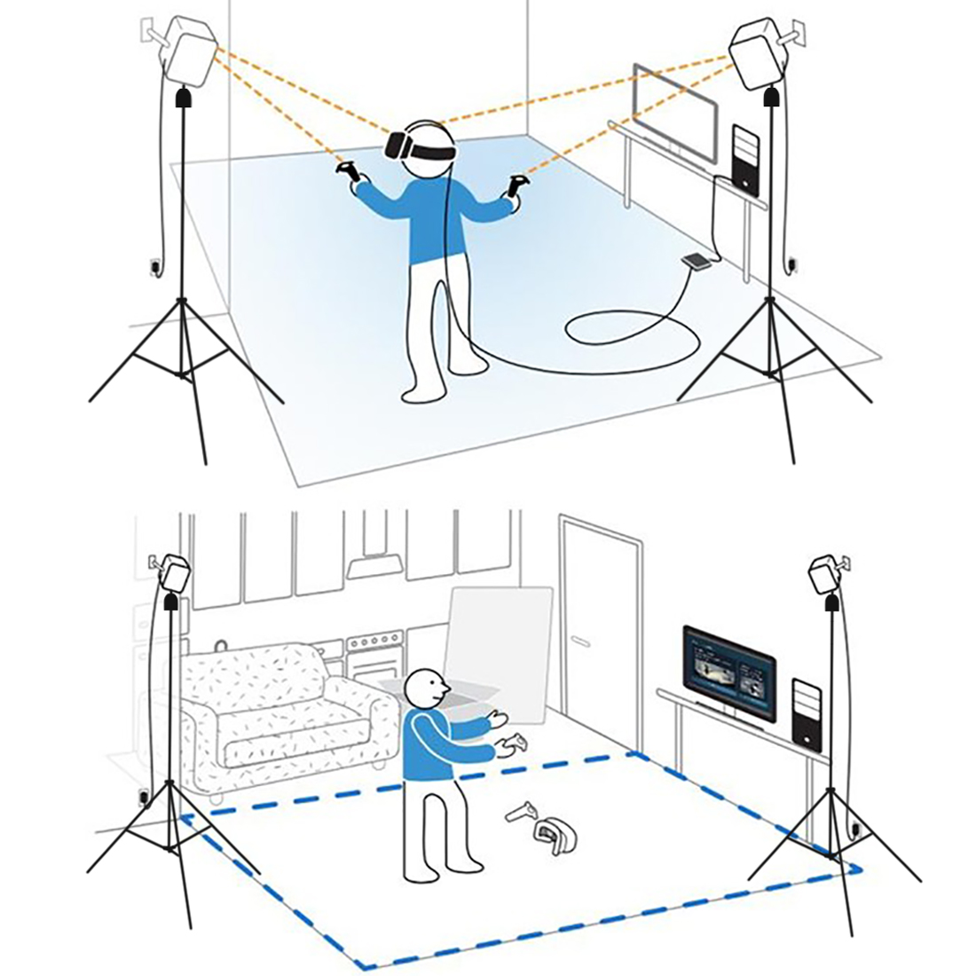
How it Works
Positional Tracking
Oculus Constellation
Vive Lighthouse
Inside-Out Tracking
Link to video

Slide 19
How it Works
3 DoF
6 DoF
Measures Rotation of X, Y, and Z-axis
Used for Mobile VR
Additionally measures Position of X, Y, and Z-axis
Used for Desktop VR

Slide 20
Tools of VR

Slide 21
Tools of VR – Headset Desktop
Oculus Rift
Oculus Go

Slide 22
Tools of VR – Headset Desktop
HTC Vive
HTC Vive Pro

Slide 23
Tools of VR – Headset Desktop
Windows Mixed Reality Devices

Slide 24
Tools of VR – Headset Mobile
Google Cardboard
Google Daydream

Slide 25
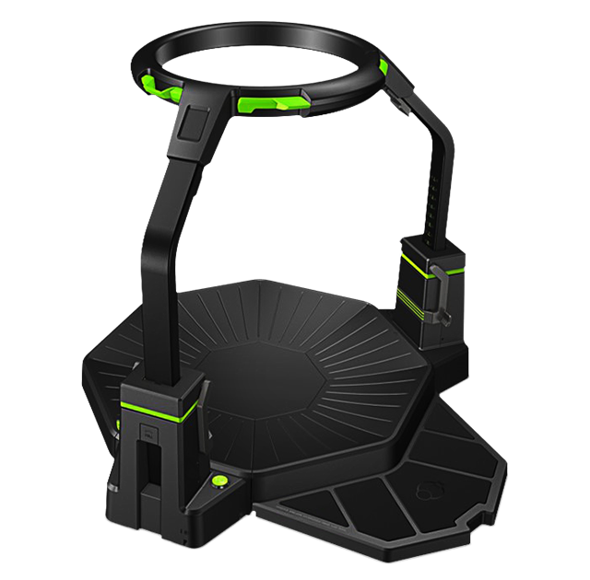
Tools of VR – 360 Treadmill
Omni by Virtuix

Slide 26
Tools of VR – Haptics
Hardlight VR Suit
Teslasuit

Slide 27
Tools of VR – Haptics
Taclim Shoes
Haptx Gloves

Slide 28
Tools of VR – Frameworks
Unity3D Engine
Unreal Engine 4

Slide 29
Tools of VR - Frameworks

Slide 30
How is VR being used?

Slide 31
How it’s Used – Social VR
Facebook Spaces
VR Chat
BigScreen VR

Slide 32
How it’s Used - Education
Virtual Tours
Chemistry
Math
Architecture
Welding
Surgery

Slide 33
Other Fields of Use
Gaming
Spatial Audio
Painting
Physical Therapy
Therapy for Mental Illnesses
Psychology / Anthropology Studies
Virtual Shopping
Machine Learning for Human Behavior

Slide 34
Questions?

