Slide 1
Pattern Generation:
With Worley Noise

Slide 2
Introduction

Slide 3
Examples of Visual Noise

Slide 4
Types of Procedural Noise
Perlin
Simplex

Slide 5
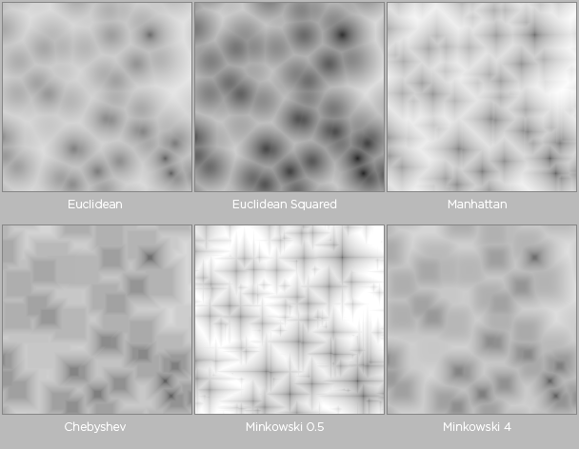
Worley Noise

Slide 6
Worley Noise
Is somewhat of a misnomer
The noise is more organic than random
This makes it good for pattern generation
Uses:
Pattern / Texture generation
Height Maps
Map Generation

Slide 7
Worley Noise: Pros
Simple to implement
Infinite number of possibilities
Noise is much more organic than Perlin or Simplex noise

Slide 8
Worley Noise: Cons
Bad O() complexity
It gets much slower as the image size increases

Slide 9
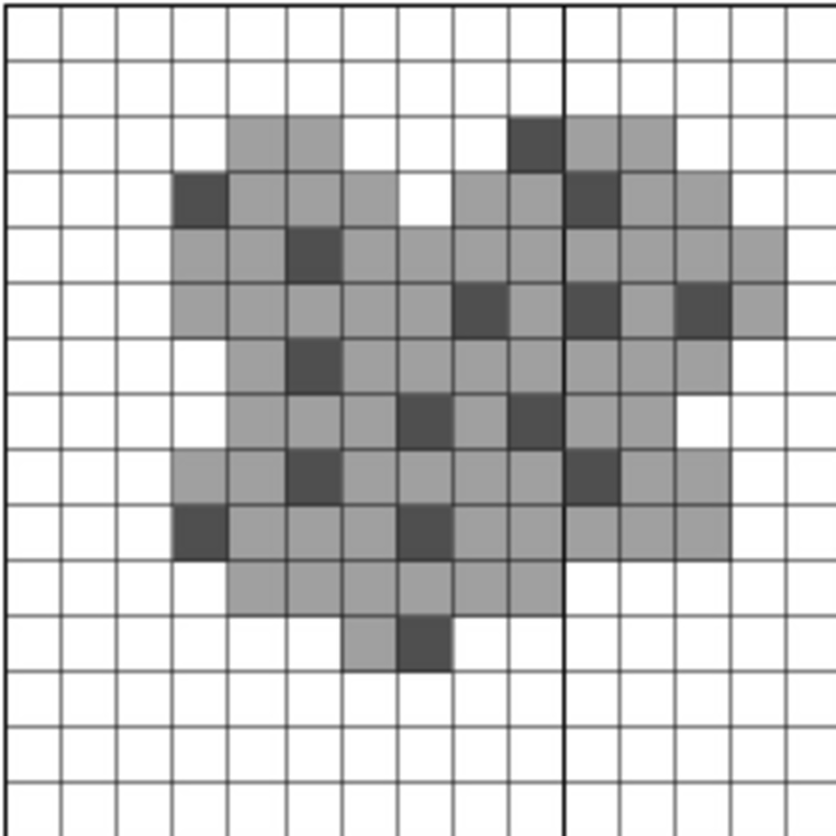
Concepts
The 2d plane:
A two dimensional grid of colored squares
The feature set:
A set of random points on the plane
The algorithm is a visualization of the distance of each pixel to its nearest feature point.

Slide 10
Algorithm
Generate a small number of points on the plane (the feature set)
For each point/square:
Find the closest feature from the list
Find the distance between the current square and the feature
Color the square based on that distance

Slide 11
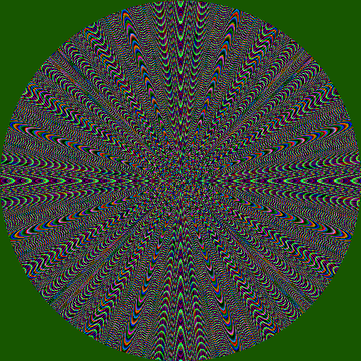
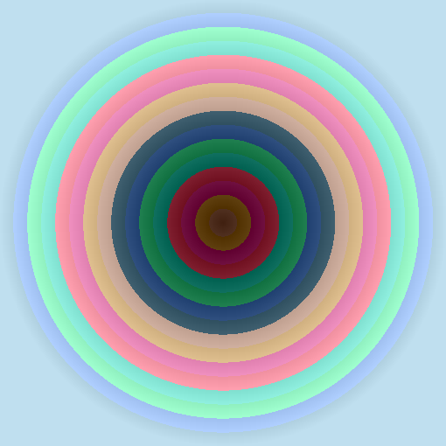
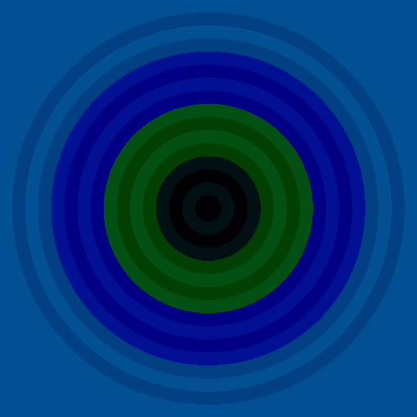
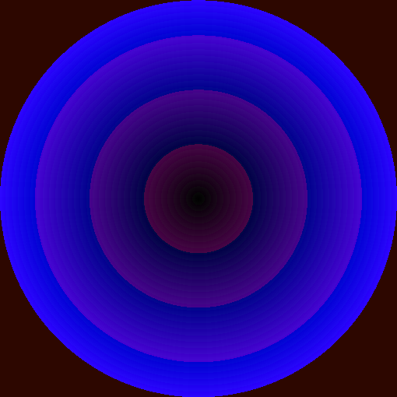
Customization:
Distance Functions:
Color Functions:
Manhattan
Linear
Xor
And
Chebyshev
Sin
Mod
Euclidean
Tan

Slide 12
“And Now here's something we hope you'll really like!”
- From an expert

Slide 13
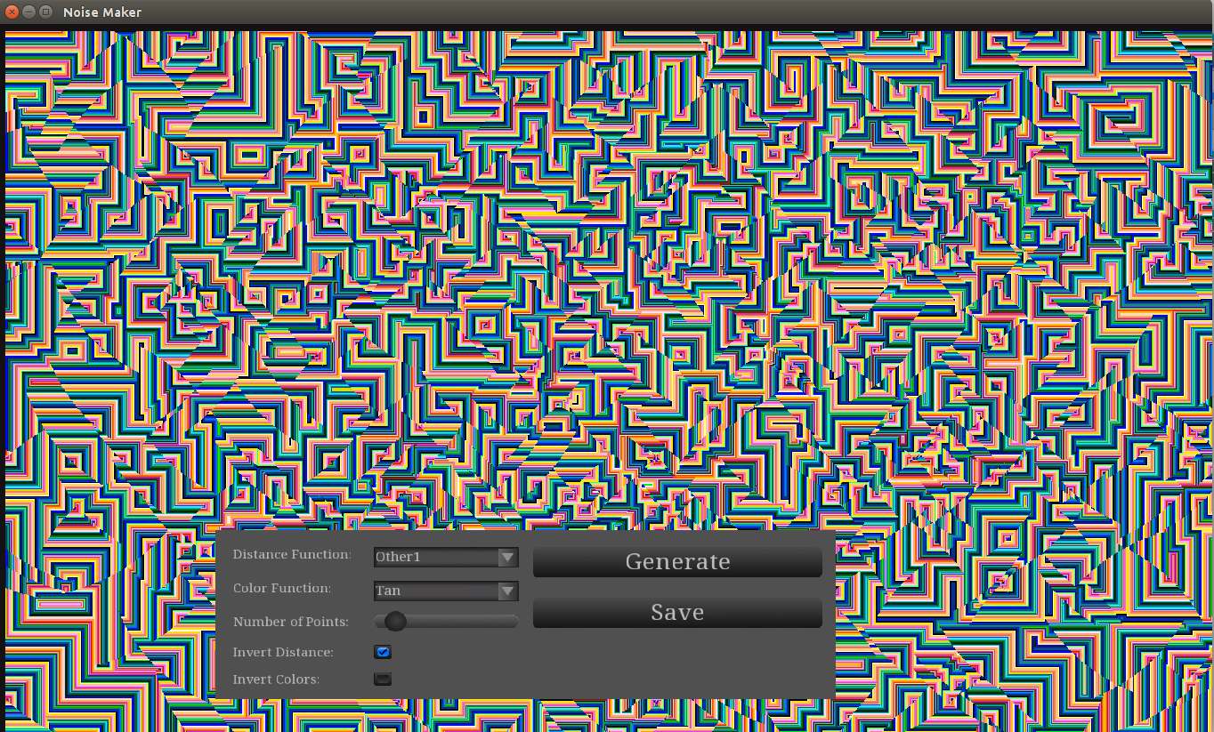
C++ Noise Generator
Graphics Framework: SFML
UI Framework: Tgui
Parallel Processing: OpenMP
Lines of Code: 455

Slide 14
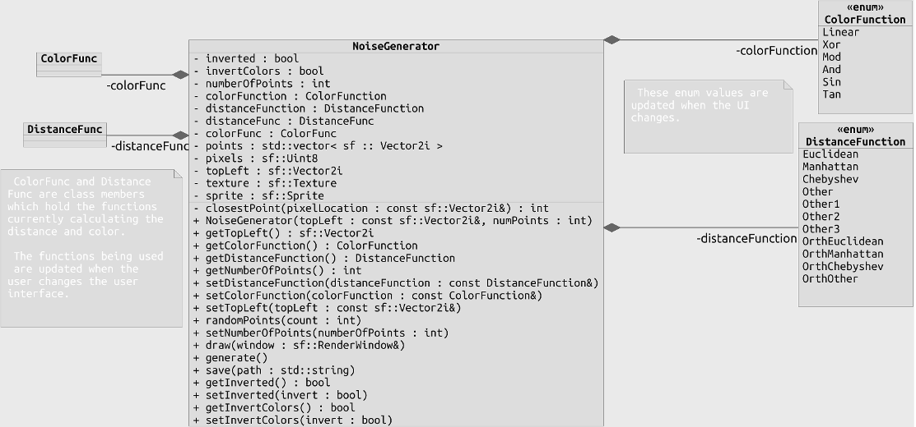
C++ Noise Generator: Class Diagram

Slide 15
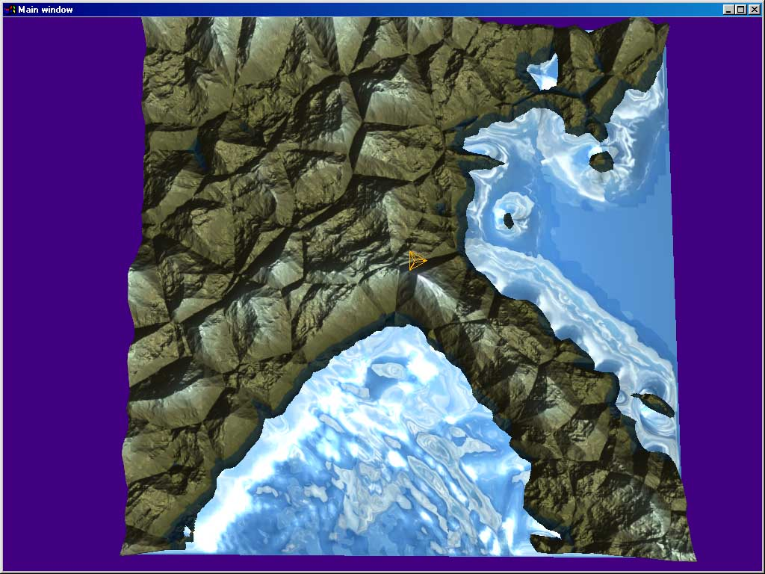
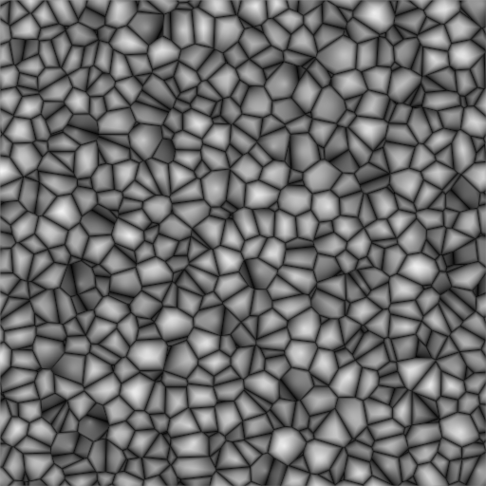
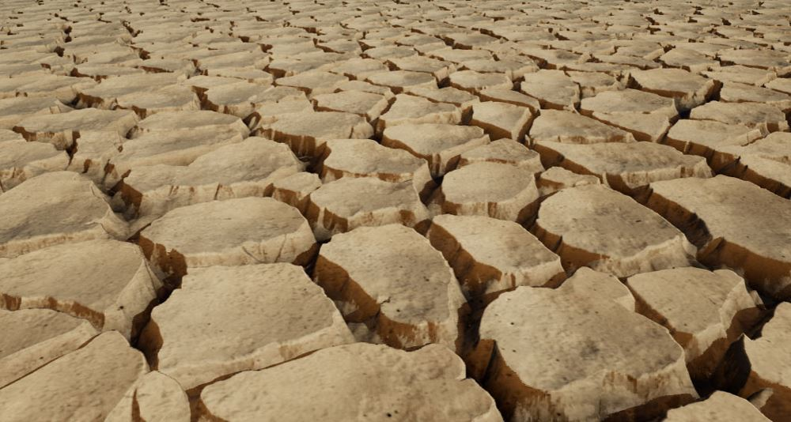
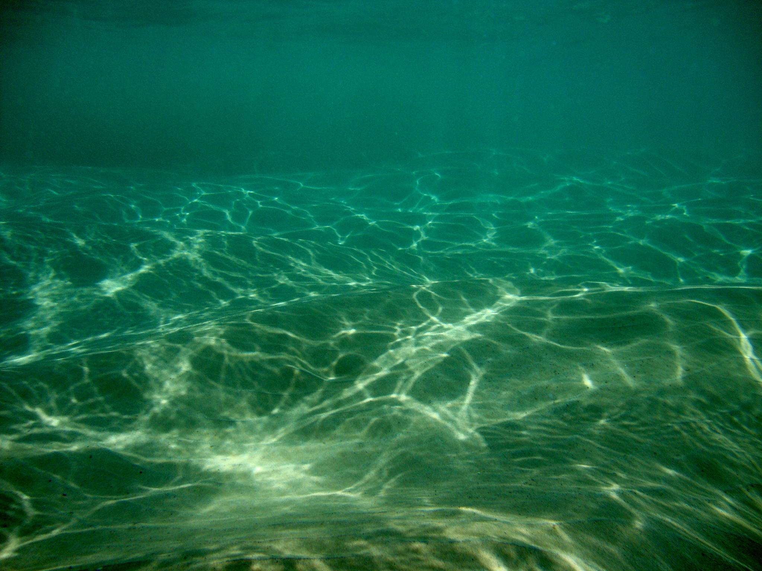
Other Uses of Worley Noise:
Using Value as Height in Landscape Generation
Also Water Reflections!

Slide 16
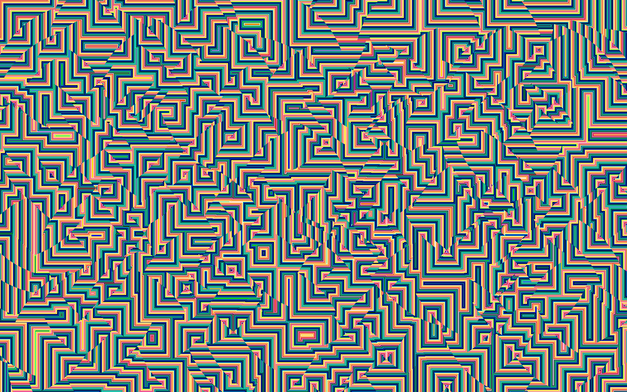
Thanks!
Code is on Github:
https://github.com/smithandrewl/noiseGenerator

